Slide 1
UNIT II
Plots, Array and Difference Equation Modelling
Vectors, Mathematical Operations on Vectors, Vector Arithmetics and Vector Function
Arrays in Python Programs-Using Lists for Collecting Function Data
Curve Plotting-The SciTools and Easyviz Packages
Plotting a Single Curve, Decorating the Plot, Plotting Multiple Curves, Controlling Line Styles
Lab 4: Curve Plotting
Numerical Python Arrays manipulations
Higher-Dimensional Arrays- Two-Dimensional Numerical Python Arrays
Matrix Objects
Mathematical Models Based on Difference Equations- Interest Rates
Lab 5: Animating a Function-temperature on earth
the Factorial as a Difference Equation
Growth of a Population, Payback of a Loan, Making a Living from a Fortune
Logistic Growth, Programming with Sound
Writing Sound to File, Reading Sound from File,
Playing Many Notes
Lab 6: Sound generated by formula and difference equation

Slide 2
Vectors, Mathematical Operations on Vectors, Vector Arithmetics and Vector Function
What is NumPy?
NumPy is a python library used for working with arrays.
NumPy is a Python library and is written partially in Python, but most of the parts that require fast computation are written in C or C++.
It also has functions for working in domain of linear algebra, fourier transform, and matrices.
NumPy was created in 2005 by Travis Oliphant. It is an open source project and you can use it freely.
NumPy stands for Numerical Python.
In Python, lists serve the purpose of arrays, but they are slow to process.
NumPy aims to provide an array object that is up to 50x faster that traditional Python lists.
The array object in NumPy is called ndarray, it provides a lot of supporting functions that make working with ndarray very easy.
Arrays are very frequently used in data science, where speed and resources are very important.
Why is NumPy Faster Than Lists?
NumPy arrays are stored at one continuous place in memory unlike lists, so processes can access and manipulate them very efficiently.
This behavior is called locality of reference in computer science.
This is the main reason why NumPy is faster than lists. Also it is optimized to work with latest CPU architectures.

Slide 3
Vectors, Mathematical Operations on Vectors, Vector Arithmetics and Vector Function
Data Types in Python
By default Python have these data types:
strings - used to represent text data, the text is given under quote marks. eg. "ABCD"
integer - used to represent integer numbers. eg. -1, -2, -3
float - used to represent real numbers. eg. 1.2, 42.42
boolean - used to represent True or False.
complex - used to represent a number in complex plain. eg. 1.0 + 2.0j, 1.5 + 2.5j
Data Types in NumPy
NumPy has some extra data types, and refer to data types with one character, like i for integers, u for unsigned integers etc.
Below is a list of all data types in NumPy and the characters used to represent them.
i - integer b - boolean
u - unsigned integer f - float
c - complex float m - timedelta
M - datetime O - object
S - string U - unicode string
V - fixed chunk of memory for other type ( void )
Example:
import numpy as np Output:
arr = np.array([1, 2, 3, 4], dtype='i4') [1 2 3 4]
print(arr); print(arr.dtype) int32

Slide 4
Vectors, Mathematical Operations on Vectors, Vector Arithmetics and Vector Function
List vs Array
Arrays need to be declared. Lists don’t, since they are built into Python.
Lists are created by simply enclosing a sequence of elements into square brackets.
Creating an array, on the other hand, requires a specific function from either the array module (i.e., array.array()) or NumPy package (i.e., numpy.array()).
Because of this, lists are used more often than arrays.
Arrays can store data very compactly and are more efficient for storing large amounts of data.
Arrays are great for numerical operations; lists cannot directly handle math operations. For example, you can divide each element of an array by the same number with just one line of code. If you try the same with a list, you’ll get an error.
To use arrays in Python, you need to import either an array module or a NumPy package.
list = [3, 6, 9, 12] import array as arr
print(list) import numpy as np
print(type(list))
Output
[3, 6, 9, 12]
<class 'list'>

Slide 5
A list object is handy for storing tabular data, such as a sequence of objects or a table of objects. An array is very similar to a list, but less flexible and computationally much more efficient.
NumPy is used to work with arrays. The array object in NumPy is called ndarray.create a NumPy ndarray object by using the array() function.
import numpy as np arr = np.array([1, 2, 3, 4, 5]) print(arr) print(type(arr))
To create an ndarray, we can pass a list, tuple or any array-like object into the array() method, and it will be converted into an ndarray
arr = np.array((1, 2, 3, 4, 5))
2D array:
arr = np.array([[1, 2, 3], [4, 5, 6]])
Access array element:
print('2nd element on 1st dim: ', arr[0, 1])

Slide 6
Vectors, Mathematical Operations on Vectors, Vector Arithmetics and Vector Function
The Python array module requires all array elements to be of the same type. Moreover, to create an array, you’ll need to specify a value type. In the code below, the “i” signifies that all elements in array_1 are integers:
array_1 = arr.array("i", [3, 6, 9, 12])
print(array_1)
print(type(array_1))
Output:
array('i', [3, 6, 9, 12])
<class 'array.array'>
On the other hand, NumPy arrays support different data types. To create a NumPy array, you only need to specify the items (enclosed in square brackets, of course):
array_2 = np.array(["numbers", 3, 6, 9, 12])
print (array_2)
print(type(array_2))
Output:
['numbers' '3' '6' '9' '12']
<class 'numpy.ndarray'>

Slide 7
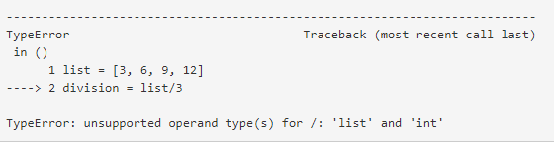
Vectors, Mathematical Operations on Vectors, Vector Arithmetics and Vector Function
List vs Array
If you need to store a relatively short sequence of items and you don’t plan to do any mathematical operations with it, a list is the preferred choice. This data structure will allow you to store an ordered, mutable, and indexed sequence of items without importing any additional modules or packages.
If you have a very long sequence of items, consider using an array. This structure offers more efficient data storage.
If you plan to do any numerical operations with your combination of items, use an array. Data analytics and data science rely heavily on (mostly NumPy) arrays.
array = np.array([3, 6, 9, 12]) list = [3, 6, 9, 12]
division = array/3 division = list/3
print(division)
print (type(division))
Output:
[1. 2. 3. 4.]
<class 'numpy.ndarray'>

Slide 8
Vectors, Mathematical Operations on Vectors, Vector Arithmetics and Vector Function
linspace is an in-built function in Python’s NumPy library. It is used to create an evenly spaced sequence in a specified interval.
The function signature of linspace is:
Required parameters
start: The starting value of the sequence.
end: The end value of the sequence unless the endpoint is set to False.
Optional parameters
num: The number of samples needed to generate within the interval. The default value is 50.
endpoint: If the endpoint is set to false, then the end value is not included in the sequence.
retstep : If the retstep is true then (samples, step) is returned. **Step​ refers to the spacing between the values in the interval.
dtype: The type of output array. The datatype is inferred if it is ​not specified.
axis: The axis in the result to store the samples.

Slide 9
Vectors, Mathematical Operations on Vectors, Vector Arithmetics and Vector Function
yellow: ’y’
magenta: ’m’
cyan: ’c’
red: ’r’
green: ’g’
blue: ’b’
white: ’w’
black: ’k’
Lots of markers at data points are available:
. plus sign: ’+’
. circle: ’o’
. asterisk: ’*’
. point: ’.’
. cross: ’x’
square: ’s’
. diamond: ’d’
. upward-pointing triangle: ’^’
. downward-pointing triangle: ’v’
. right-pointing triangle: ’>’
. left-pointing triangle: ’<’
. five-point star (pentagram): ’p’
. six-point star (hexagram): ’h’
. no marker (default): None
The different available line types are
. solid line: ’-’
. dashed line: ’--’
. dotted line: ’:’
. dash-dot line: ’-.’

Slide 10
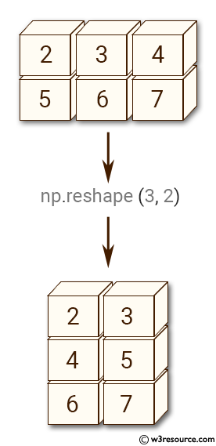
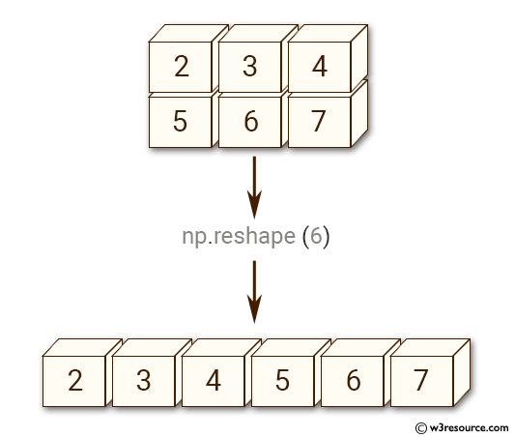
Numerical Python Arrays manipulations
The reshape() function is used to give a new shape to an array without changing its data.

Slide 11
Array functionality
array(ld) copy list data ld to a numpy array
asarray(d) make array of data d (copy if necessary)
zeros(n) make a vector/array of length n, with zeros (float)
zeros(n, int) make a vector/array of length n, with int zeros
zeros((m,n), float) make a two-dimensional with shape (m,n)
zeros(x.shape, x.dtype) make array with shape and element type as x
linspace(a,b,m) uniform sequence of m numbers between a and b
seq(a,b,h) uniform sequence of numbers from a to b with step h
iseq(a,b,h) uniform sequence of integers from a to b with step h
a.shape tuple containing a’s shape
a.size total no. of elements in a
len(a) length of a one-dim. array a (same as a.shape[0])
a.reshape(3,2) return a reshaped as 2 × 3 array
a[i] vector indexing
a[i,j] two-dim. array indexing
a[1:k] slice: reference data with indices 1,. . . ,k-1
a[1:8:3] slice: reference data with indices 1, 4,. . . ,7
b = a.copy() copy an array
sin(a), exp(a), ... numpy functions applicable to arrays
c = concatenate(a, b) c contains a with b appended
c = where(cond, a1, a2) c[i] = a1[i] if cond[i], else c[i] = a2[i] isinstance(a, ndarray)

Slide 12



Interest Rates
how much money an initial amount x0 will grow to after n years in a bank with annual interest rate p.
this formula arises after some limiting assumptions, like that of a constant interest rate over all the n years.
Moreover, the formula only gives us the amount after each year, not after some months
or days.
Suppose now that we are interested in computing the growth of money after N days instead.
The interest rate per day is taken as r = p/D if p is the annual interest rate and D is the number of days in a year.
The fundamental model is the same, but now n counts days and p is replaced by r:
Python has a module datetime for convenient calculations with dates and times.

Slide 13
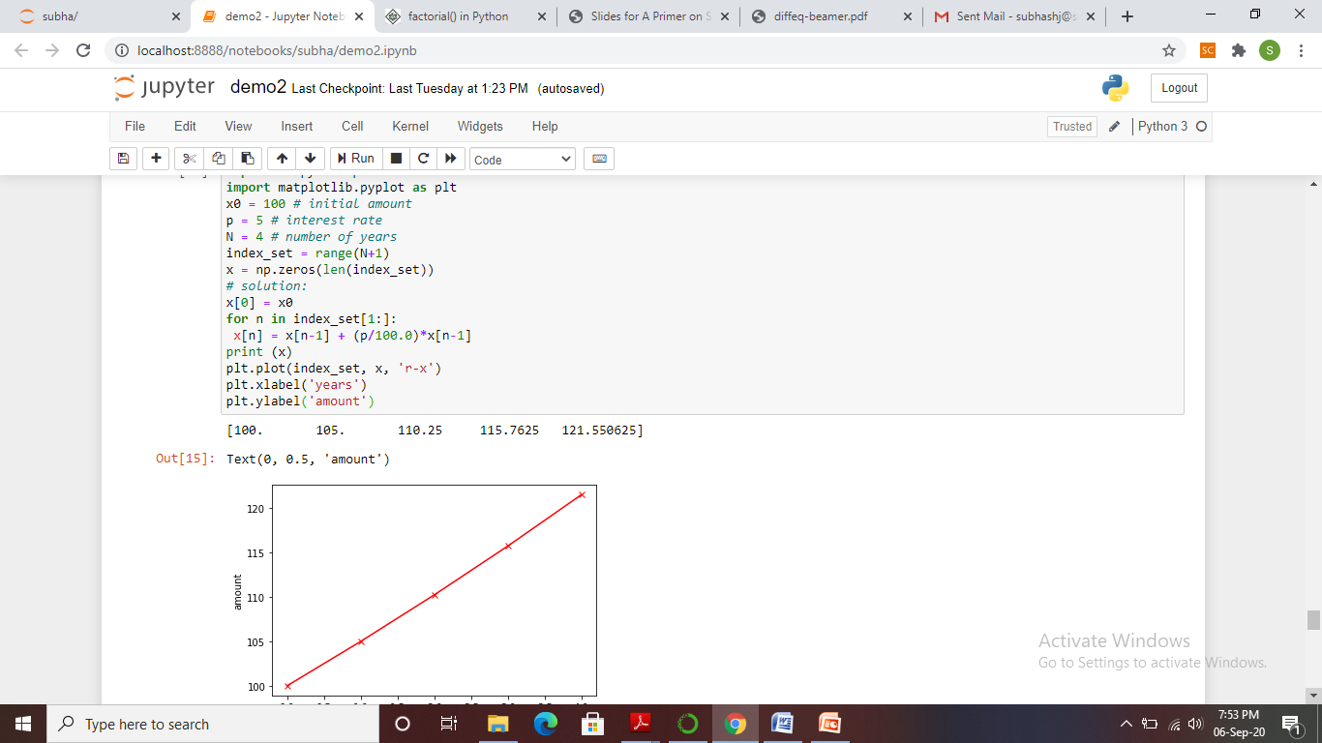
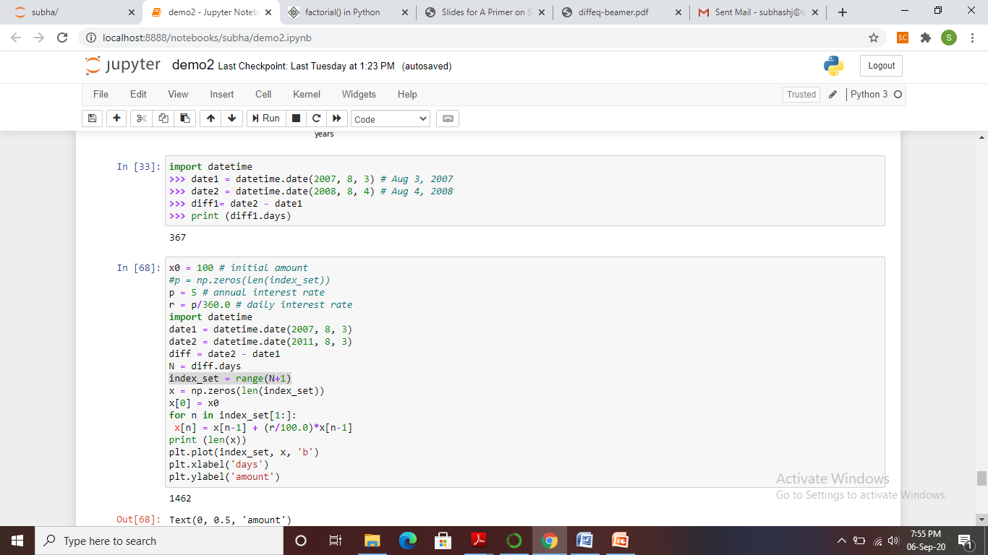
Interest Rates

Slide 14
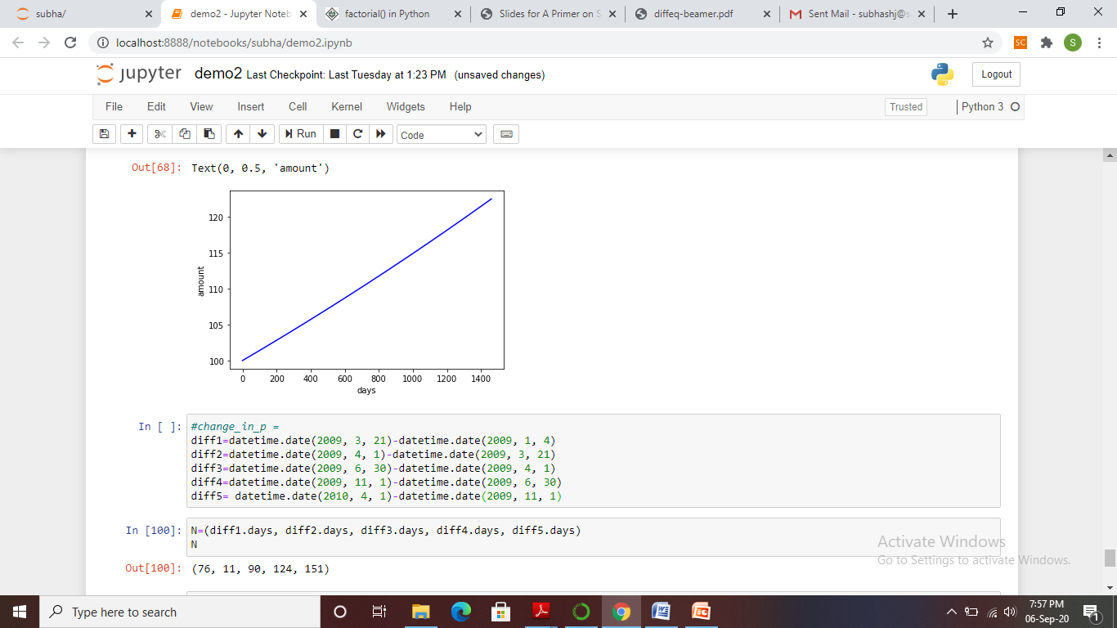
Interest Rates

Slide 15
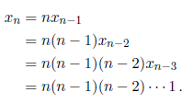
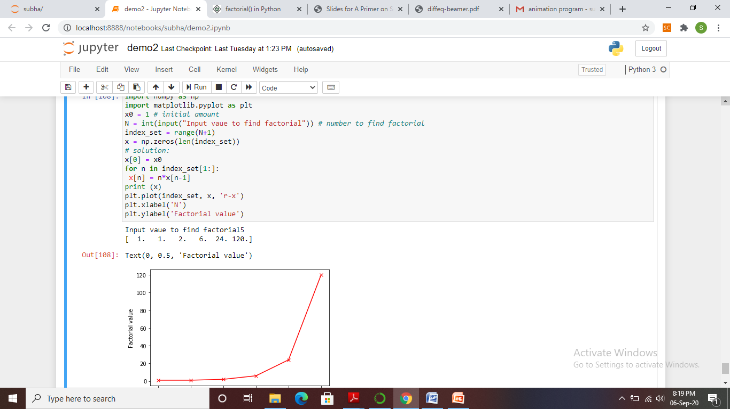
The Factorial as a Difference Equation

Slide 16

Growth of a Population
Let xn−1 be the number of individuals in a population at time tn−1.
Between time levels tn−1 and tn, bxn individuals are born, and dxn individuals die, where b and d are constants.
the values of b and d are smaller if n counts years than if n counts generations.
The net growth of the population is then (b − d)xn.
Introducing r = (b − d)100 for the net growth factor measured in percent, the new number of individuals become

Slide 17
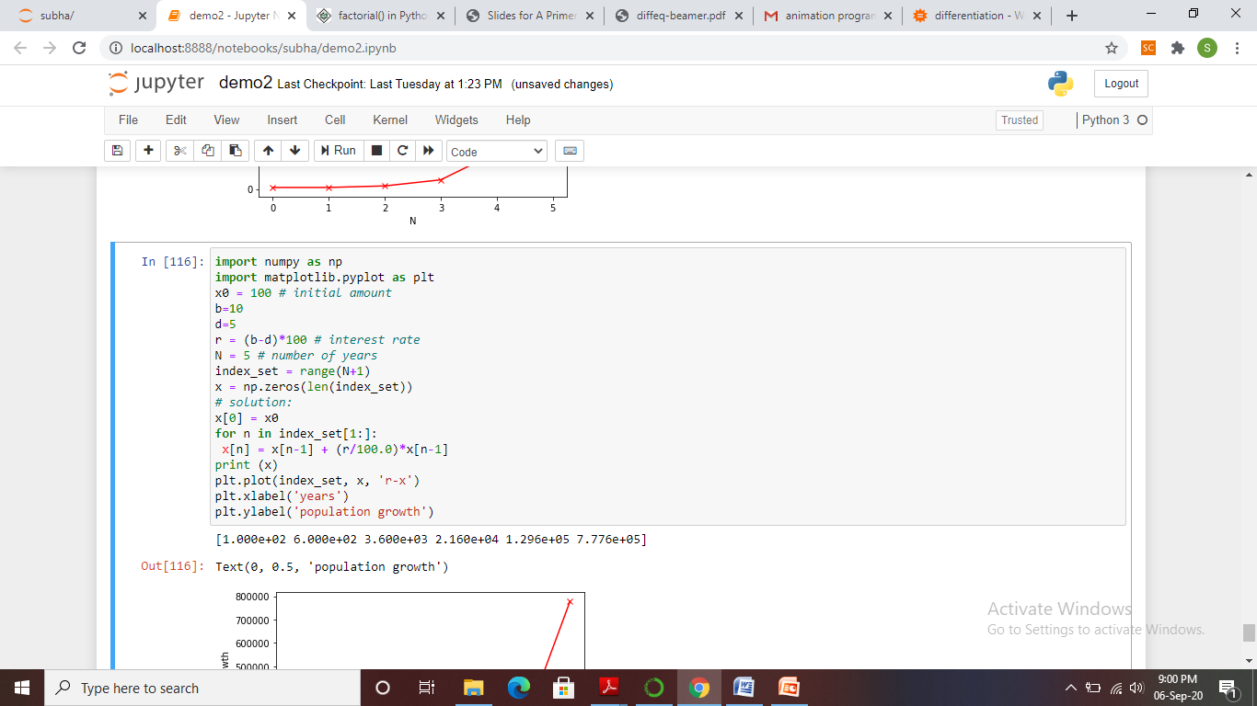
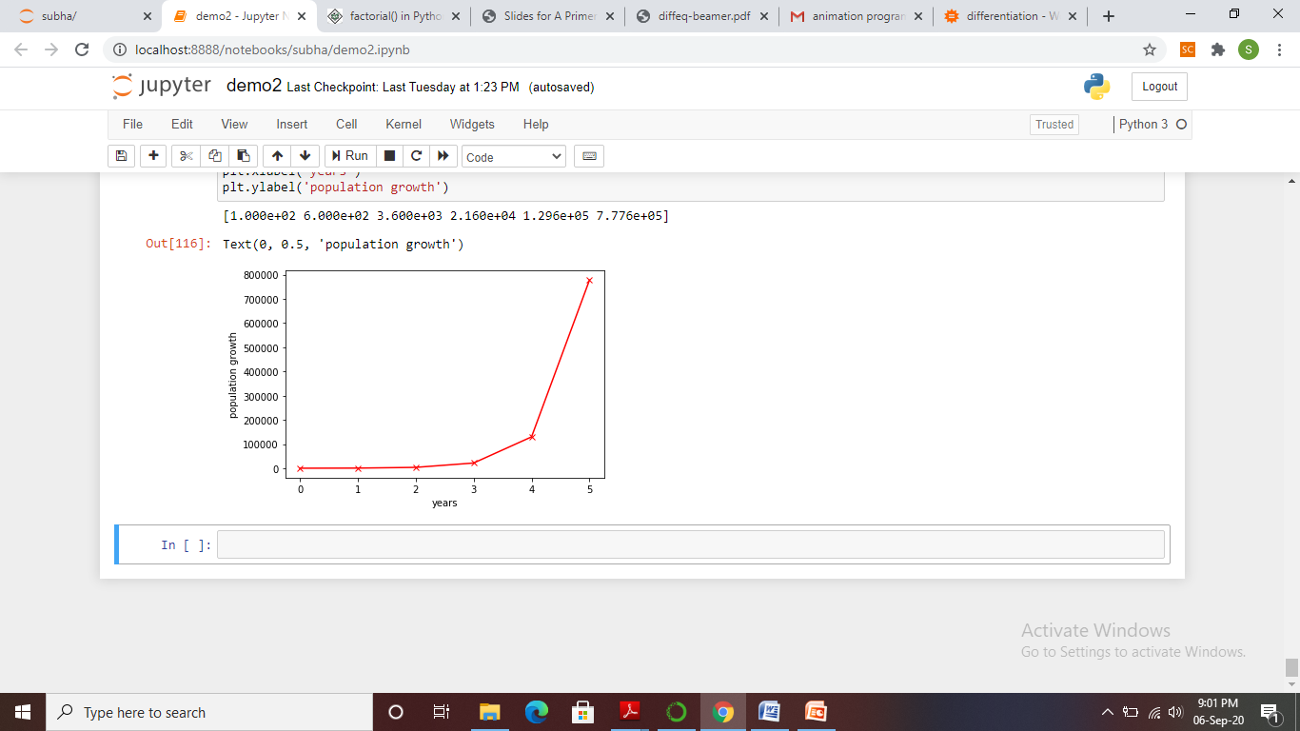
Growth of a Population

Slide 18
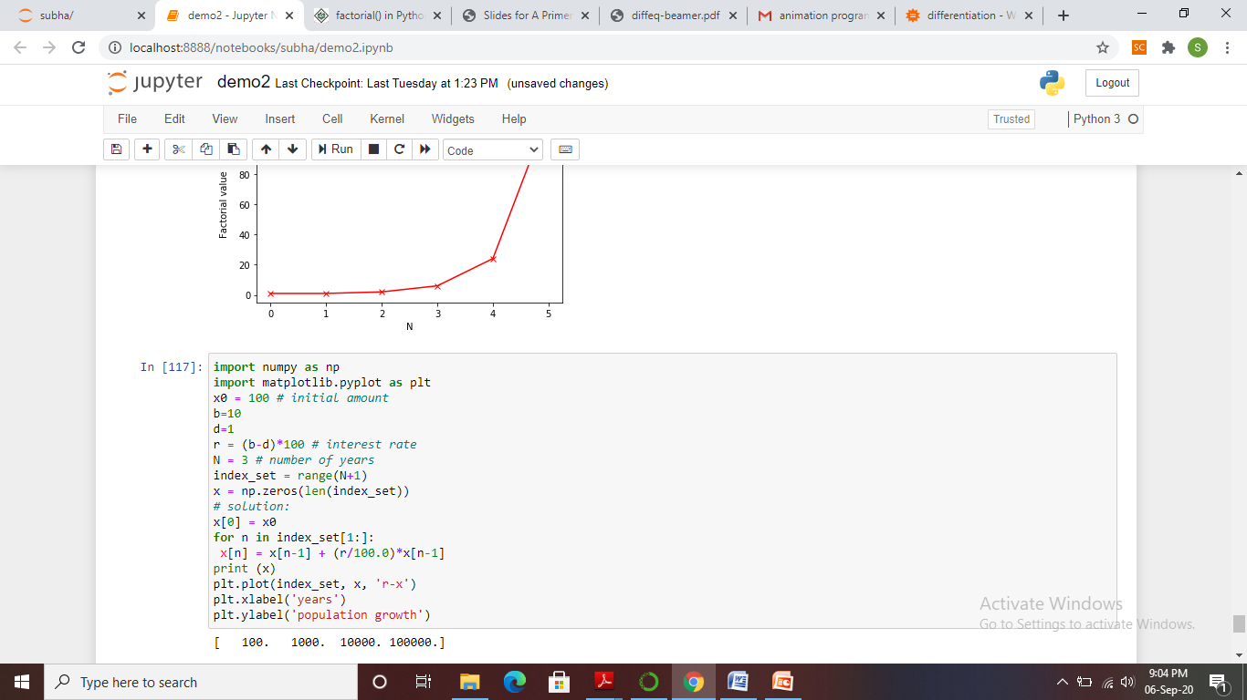
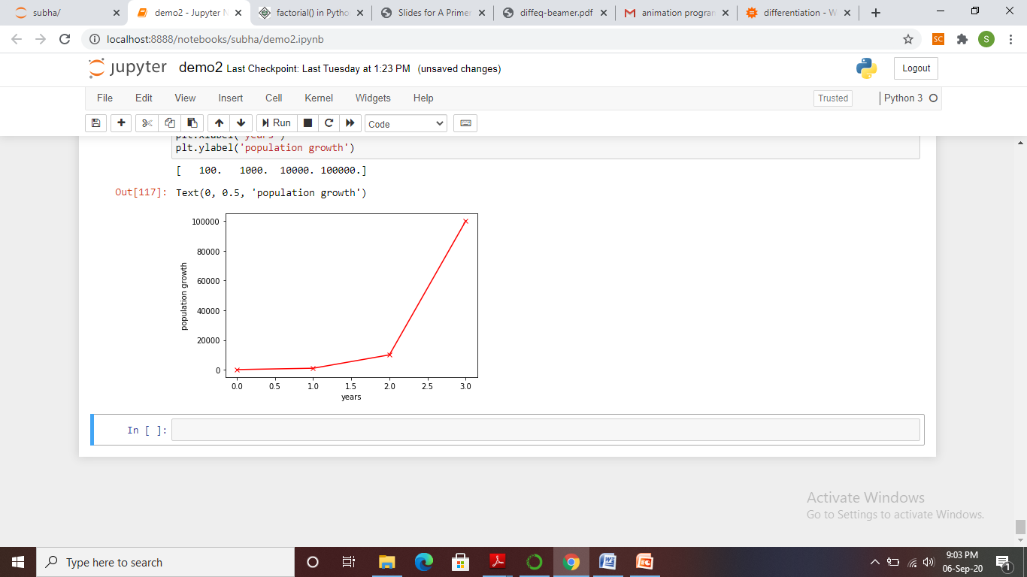
Growth of a Population

Slide 19



Logistic Growth
The size of the population increases faster and faster as time n increases, and xn → ∞ when n → ∞.
In real life, however, there is an upper limit M of the number of individuals that can exist in the environment at the same time.
Lack of space and food, competition between individuals, predators, and spreading of contagious diseases are examples on factors that limit the growth.
The number M is usually called the carrying capacity of the environment, the maximum population which is sustainable over time.
With limited growth, the growth factor r must depend on time:
For small n, xn ≪ M and r(n) ≈ ρ which is the growth rate with unlimited resources. As n → M, r(n) → 0 as we want.

Slide 20
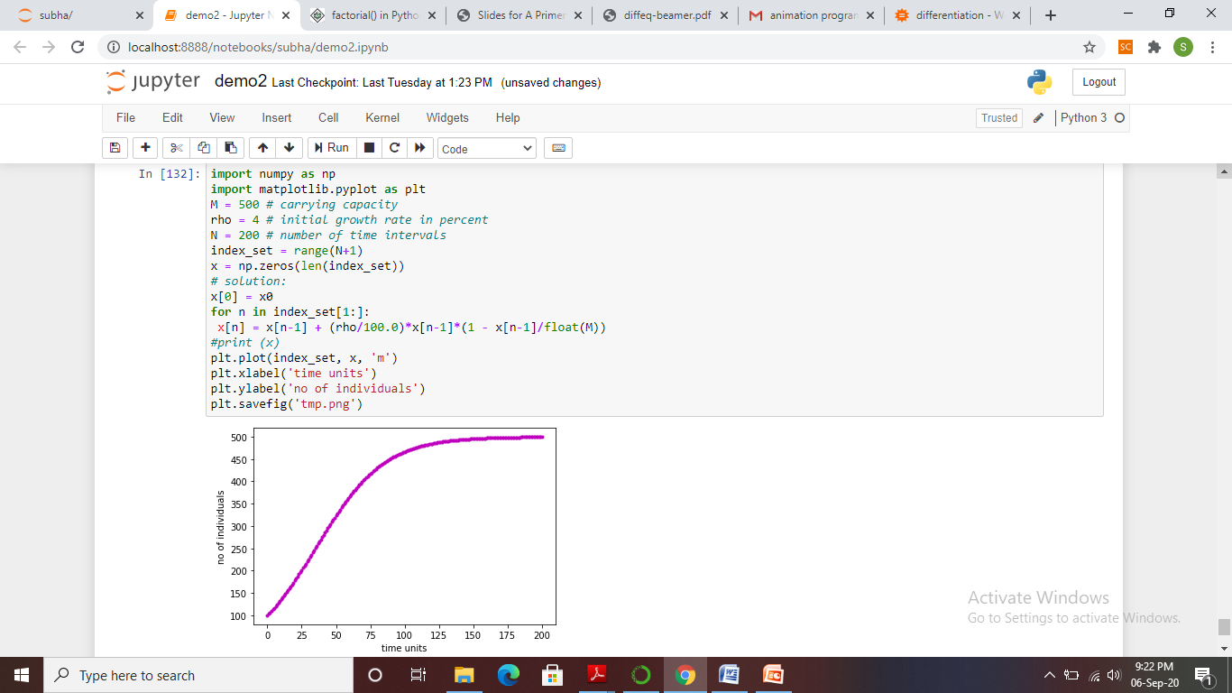
Logistic Growth

Slide 21

Payback of a Loan
A loan L is to be paid back over N months. The payback in a month consists of the fraction L/N plus the interest increase of the loan.
Let the annual interest rate for the loan be p percent.
The monthly interest rate is then p/12 .
The value of the loan after month n is xn, and the change from xn−1 can be modeled as

Slide 22
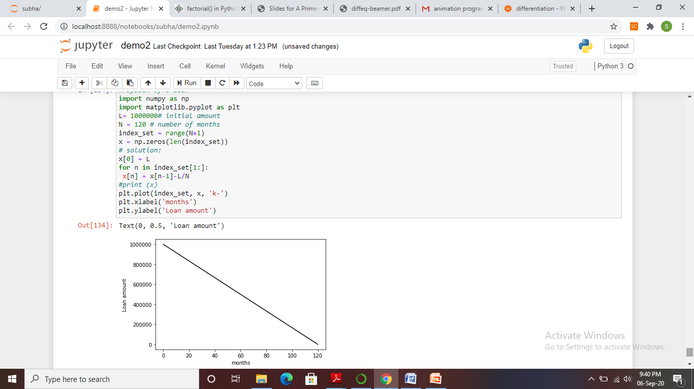
Payback of a Loan

Slide 23

Payback of a Loan
The solution of previous slide is not particularly exciting6.
What is more interesting, is what we pay each month, yn. We can keep track of both yn and xn in a variant of the previous model:

Slide 24
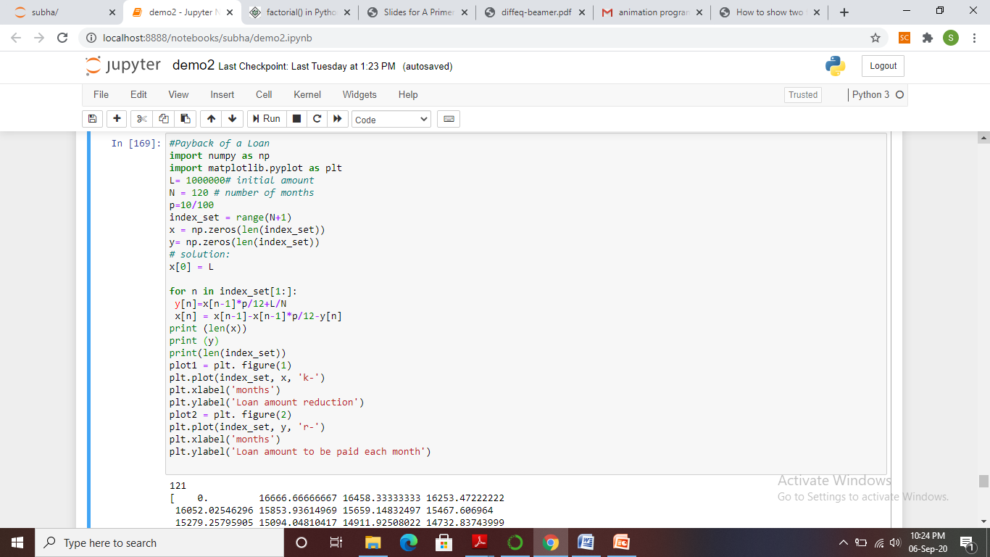
Payback of a Loan

Slide 25
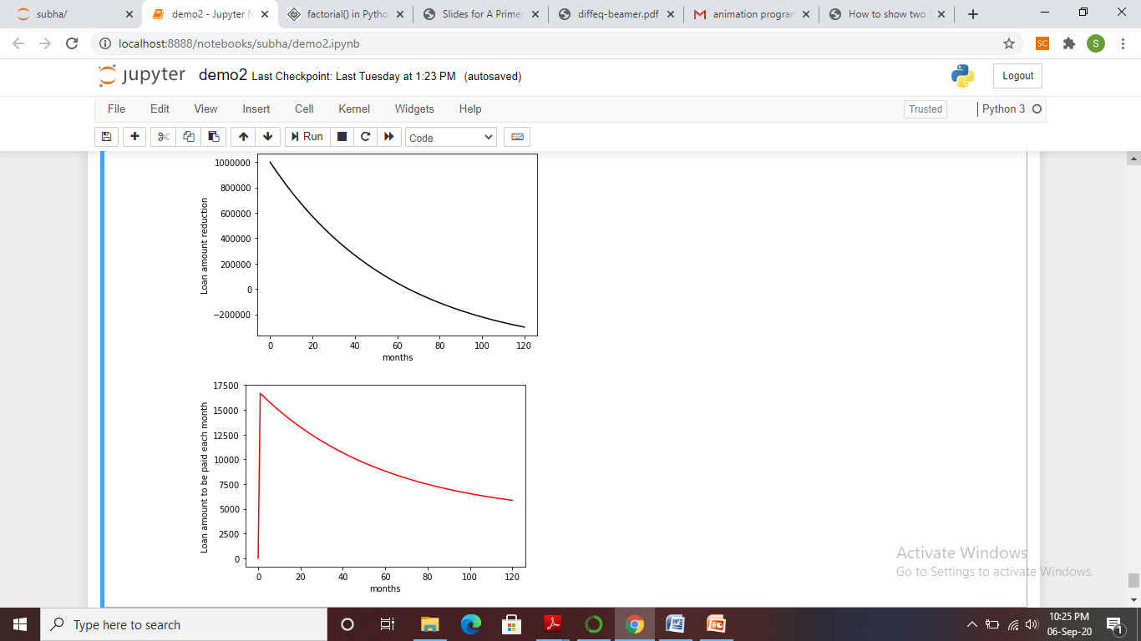
Payback of a Loan

Slide 26
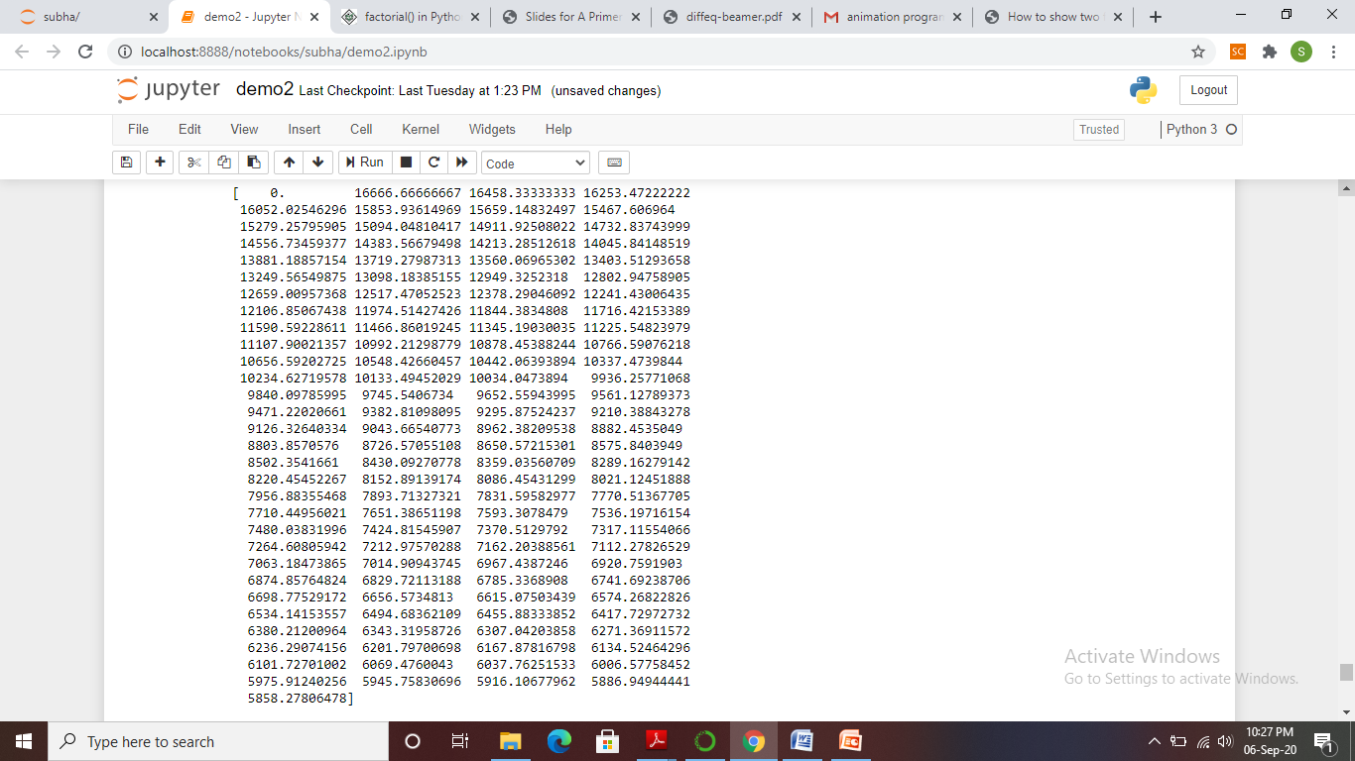
Payback of a Loan

Slide 27


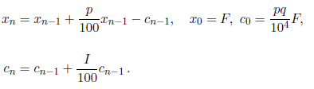

Making a Living from a Fortune
Suppose you want to live on a fortune F. You have invested the money
in a safe way that gives an annual interest of p percent.
Every year you plan to consume an amount cn, where n counts years. The development of your fortune xn from one year to the other can then be modeled by
A simple example is to keep c constant, say q percent of the interest the first year:
A more realistic model is to assume some inflation of I percent per year.

Slide 28
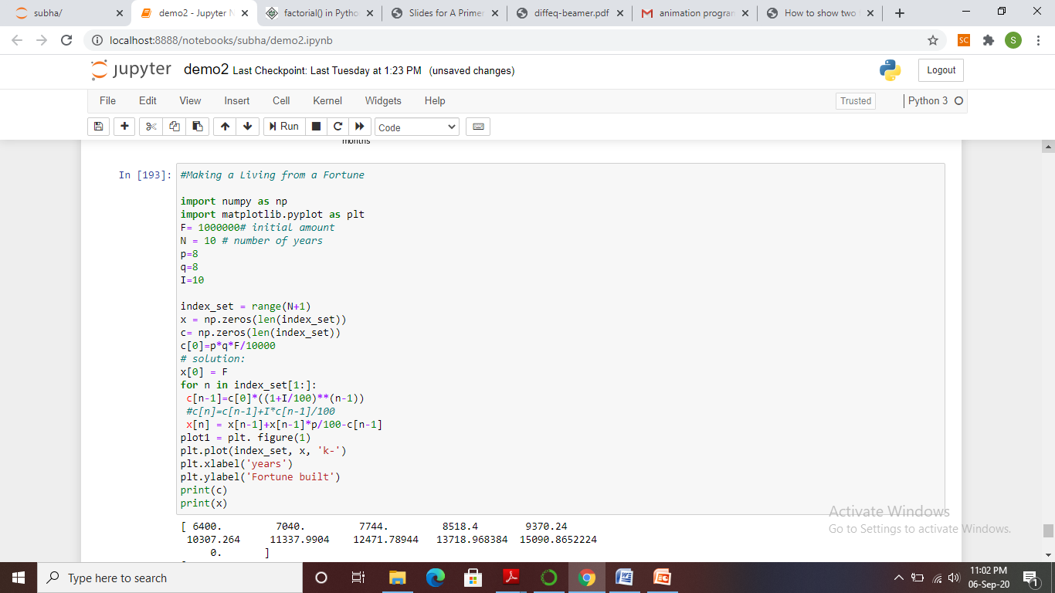
Making a Living from a Fortune

Slide 29
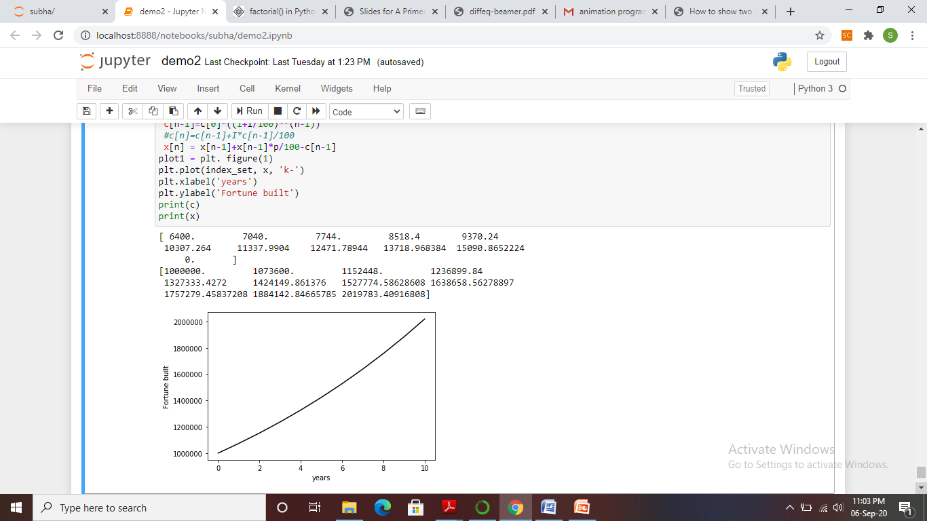
Making a Living from a Fortune

Slide 30
Matrix -Summary
A Python matrix is a specialized two-dimensional rectangular array of data stored in rows and columns. The data in a matrix can be numbers, strings, expressions, symbols, etc. Matrix is one of the important data structures that can be used in mathematical and scientific calculations.
Python does not have a straightforward way to implement a matrix data type. Python matrix can be created using a nested list data type and by using the numpy library.
The python library Numpy helps to deal with arrays. Numpy processes an array a little faster in comparison to the list.
The matrix operation that can be done is addition, subtraction, multiplication, transpose, reading the rows, columns of a matrix, slicing the matrix, etc.
To add two matrices, you can make use of numpy.array() and add them using the (+) operator.
To multiply them will, you can make use of the numpy dot() method. Numpy.dot() is the dot product of matrix M1 and M2. Numpy.dot() handles the 2D arrays and perform matrix multiplications.
The transpose of a matrix is calculated by changing the rows as columns and columns as rows. The transpose() function from Numpy can be used to calculate the transpose of a matrix.
Slicing of a matrix will return you the elements based on the start /end index given.

Slide 31
Sound program example
Step1: Have to install simpleaudio in python
https://pypi.org/project/simpleaudio/
pip install simpleaudio
Step 2: open a command prompt
Type pip install simpleaudio and enter.
Program:
import numpy as np
import simpleaudio as sa
frequency = 440 # Our played note will be 440 Hz
fs = 44100 # 44100 samples per second
seconds = 4 # Note duration of 3 seconds
# Generate array with seconds*sample_rate steps, ranging between 0 and seconds
t = np.linspace(0, seconds, seconds * fs, False)
# Generate a 440 Hz sine wave
note = np.sin(frequency * t * 2 * np.pi)
# Ensure that highest value is in 16-bit range
audio = note * (2**15 - 1) / np.max(np.abs(note))
# Convert to 16-bit data
audio = audio.astype(np.int16)
# Start playback
play_obj = sa.play_buffer(audio, 1, 2, fs)
# Wait for playback to finish before exiting
play_obj.wait_done()

Slide 32
Animation
Matplotlib library of Python is a plotting tool used to plot graphs of functions or figures. It can also be used as an animation tool too.
The plotted graphs when added with animations gives a more powerful visualization and helps the presenter to catch a larger number of audience
Animations in Matplotlib can be made by using the Animation class in two ways:
By calling a function over and over: It uses a predefined function which when ran again and again creates an animation.
set a blank figure or a blank window on which the entire animation will be drawn.
Next we initialize a variable line which will contain the x and y co-ordinates of the plot.
These are kept empty at first as the data in it will continuously keep changing because of the animation. Finally, we state the animation function animate(i) which takes an argument i, where i is called the frame number and using this we create the sine wave(or any other figure) which will continuously vary depending upon the value of i.
In the last line anim = FuncAnimation(fig, animate, init_func=init, frames=200, interval=20, blit=True)
use the FuncAnimation function to create an animation which will display 200 frames per second and in an interval of 20 micro secs.
encapsulated in the new to_jshtml method, we are now able to embed an interactive JavaScript widget for playback of Matplotlib animations directly inside a Jupyter Notebook.
Now to create an interactive JavaScript widget using the to_jshtml method:

Slide 33
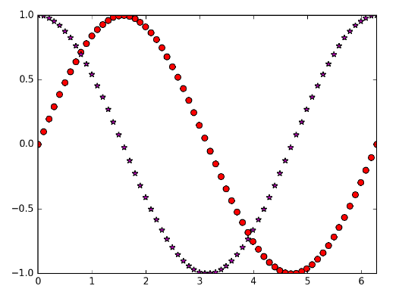
Example
As can be seen from code, in init function we set our x and y axis limits. In the update function, the arrays x, ysin and ycos are appended with respective values and functions.
A Line2D object has set_data function in which you can pass the x values and y values. Now it’s time to call our main animation function.

Slide 34
import numpy as np
import matplotlib.pyplot as plt
from matplotlib.animation import FuncAnimation, PillowWriter
%matplotlib notebook #will lead to interactive plots embedded within the notebook, you can zoom and resize the figure
#To begin, we will initialize empty objects as shown below
fig, ax = plt.subplots()
x, ysin, ycos = [], [], []
ln1, = plt.plot([], [], 'ro')
ln2, = plt.plot([], [], 'm*')
#Please note that the call to plt.plot([],[], ‘ro’) returns a tuple with one element. This is
#unpacked into a variable ln1. To unpack single item tuples, this convention is #followed. If you print the type of ln1 and ln2, you will get a Line2D object.
def init():
ax.set_xlim(0, 2*np.pi)
ax.set_ylim(-1, 1)
def update(i):
x.append(i)
ysin.append(np.sin(i))
ycos.append(np.cos(i))
ln1.set_data(x, ysin)
ln2.set_data(x, ycos)
ani = FuncAnimation(fig, update, np.linspace(0, 2*np.pi, 64), init_func=init)
plt.show()
Animation-example code

